Slide 1
Highway navigation system USING LIght-FIdelity
Presented By
MOHAMED YOOSUF I - 2018105030
suriya R -2018105064
bharathwaj m -2018105515
gunalan s -2018105533
Project Guide
Dr m.a.bhagyaveni
TEAM ID:
26-PWB2B322

Slide 2
aBSTRACT
The project deals with the implementation of a LIGHT-FIDELITY based module for
HIGHWAY NAVIGATION SYSTEM. The system is designed and implemented on the
principle of transmission through LED and reception using a Li- Fi Receiver.
It uses visible light communication which works by switching bulbs on and off within nanoseconds.

Slide 3
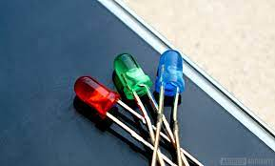
Light fidelity
LIFI is the transmission of data through illumination i.e. sending data through a LED light bulb that varies in intensity faster than human eyes can follow.
It is a LIGHT based WIFI where it uses light instead of Radio waves to transmit information.

Slide 4
iNTRODUCTION
It is quite often that traveller travelling to remote areas find it difficult to get onto the
right path. The problem grows up during night, due to lack of visibility, nonfunctioning
of GPS since not everywhere on the highway we find the mobile networks which can be used for navigation.
Thus to tackle with this problem, we implement Li-Fi in the streetlights. Li-Fi
(light fidelity technology) is the technology that emerged in the field of Wireless
Communication
According to the received signal the information of present location and further
diversions is displayed on the LCD installed at the receiver. Thus, this technology is more
useful for automatic navigation on highways.

Slide 5
Literature survey
S.NO | AUTHOR NAME | TITLE | CONTENT | INFERENCE
1 | M.THANIGAVEL M .TECH CSE DEPT VOL. 2 ISSUE 10, OCTOBER - 2013 | LIFI TECHNOLOGY USING WIRELESS COMMUNICATION | COMPARISON OF BLUETOOTH, WI-FI & LI-FI. | COMPARED THE LIFI WITH OTHER WIRELESS TECHNOLOGIES AND LEARNED THE WORKING OF LIFI
2 | MAIDEEN ABDHULKADER JEYLANI,ACHUTHAN B,ARUN KUMAR B,CHIRAGSUN RL (2021) | UNDERWATER WIRELESS COMMUNICATION USING LI-FI | LIFI TRANSMITTER AND RECEIVER MODULE | LEARNED ABOUT THE TRANSMITTER SECTION
3 | D. SINGH, A. SOOD, G. THAKUR, N. ARORA AND A. KUMAR (2017) | DESIGN AND IMPLEMENTATION OF WIRELESS COMMUNICATION SYSTEM FOR TOLL COLLECTION USING LIFI | EXPLANATION OF THE COMPONENTS | UNDERSTANDING THE USAGE OF COMPONENTS

Slide 6
TRANSMITTER SECTION:
BLOCK DIAGRAM
ARDUINO UNO
LED LIGHT
REGULATED POWER SUPPLY
LED LIGHT
LED LIGHT
LCD

Slide 7
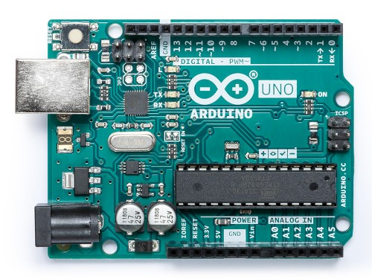
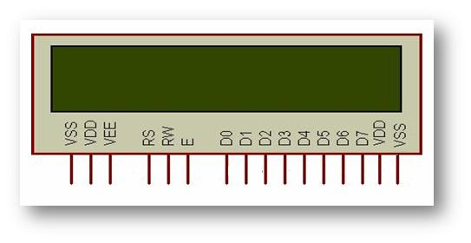
HARDWARE COMPONENTS
ARDUINO UNO:
The Arduino Uno is an open-source microcontroller board based on the Microchip ATmega328P microcontroller and developed by Arduino.cc.
LCD DISPLAY:
A 16x2 LCD means it can display 16 characters per line and there are 2 such lines. This LCD has two registers, namely, Command mode and Data mode.

Slide 8
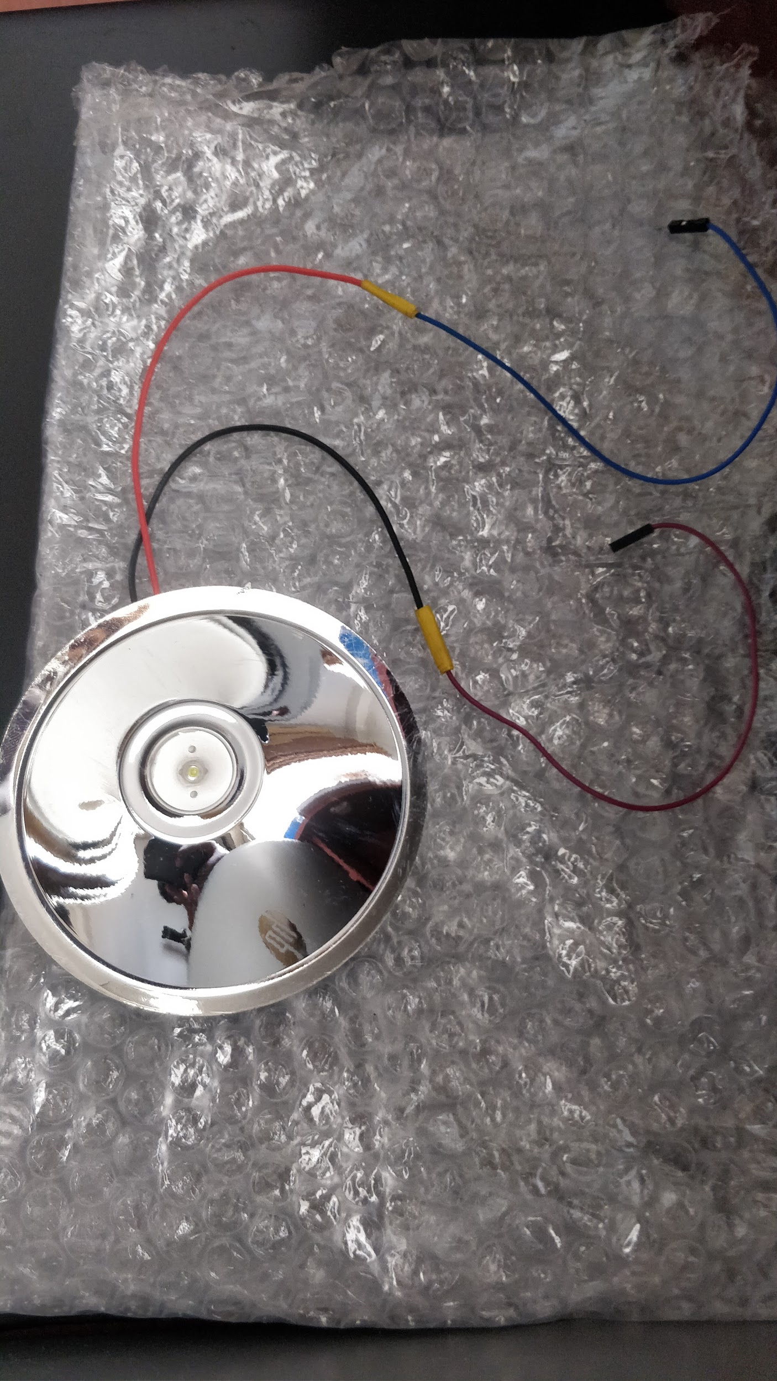
LI-FI TRANSMITTER
It transmits the data by dipping and dimming of LED. Data is fed into an LED light bulb , then it sends data at rapid speeds to the photo-detector (photodiode) in receiver side.

Slide 9
WORKING:
The circuit connections are made and the Arduino are switched on by using a power supply.
Then the code which is written in Arduino IDE software is dumped into the Arduino UNO board and made to run.
At the transmitter section the LCD module is connected to the Arduino to present the text that is transmitted.
With the help of the Li-Fi transmitter, data is transmitted at the given data rates. Here, we transmit the data as ‘text’ we get from the sensors to the receiver side.
The LED Li-Fi transmitter has its LED on while transmitting the data.
Once the Photo detector, which is the Li-Fi receiver absorbs the light it converts it back into electrical signal through which the data can be extracted

Slide 10
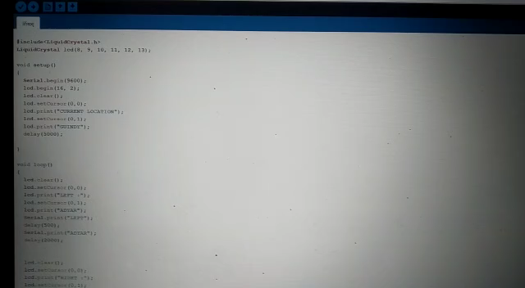
demonstration:

Slide 11
Project Workflow
Current
Stage
Implemented transmitter section
Next Stage
Hardware components of Receiver will be interfaced and the arduino code implementation will be done
Final Stage
Integrating the navigation system and final testing

Slide 12
REFERENCE
1. M. THANIGAVEL “Li-Fi Technology in Wireless Communication”, International Journal of Engineering Research & Technology, Vol. 2 Issue October 10, 2013.
2. MAIDEEN ABDHULKADER JEYLANI,ACHUTHAN B,ARUN KUMAR B,CHIRAGSUN RL"Underwater Communication Using Li-Fi," 2021 3rd International Conference on Signal Processing and Communication (ICPSC), 2021
3. D. SINGH, A. SOOD, G. THAKUR, N. ARORA AND A. KUMAR, "Design and implementation of wireless communication system for toll collection using LIFI," 2017 4th International Conference on Signal Processing, Computing and Control (ISPCC), 2017

Slide 13
THANK YOU !!

